Slide 1

Design Project
Automated Industrial Glass-Processing
System
EEE-3506: Programmable Logic Controllers
Group Members
Prof. Dr. Sırrı Sunay Gürleyük
Arş. Gör. Ali Can Erüst
Ahmet BARUT
Ahmad Zameer NAZARI

Slide 2
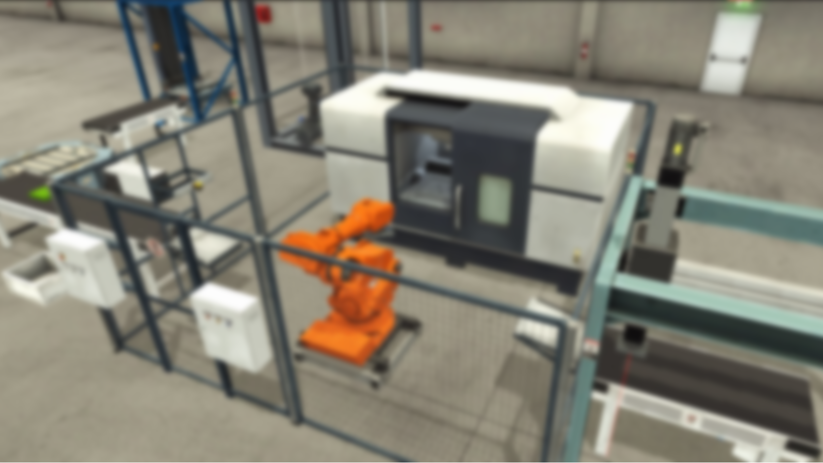
Automated Industrial Glass Processing System

Slide 3
Table of Contents
Overview
Process Flow
Process Steps with Ladder Logic
Glass Handling
Conveyor to Glass Processor
Glass Processing
Cleaning
HMI Page

Slide 4
Overview
The machining process is time-consuming, with steps like cutting, sorting, grinding, and washing. If all these processes are done on a single machine, we save a lot of time. This means we can have a faster overall process.

Slide 5
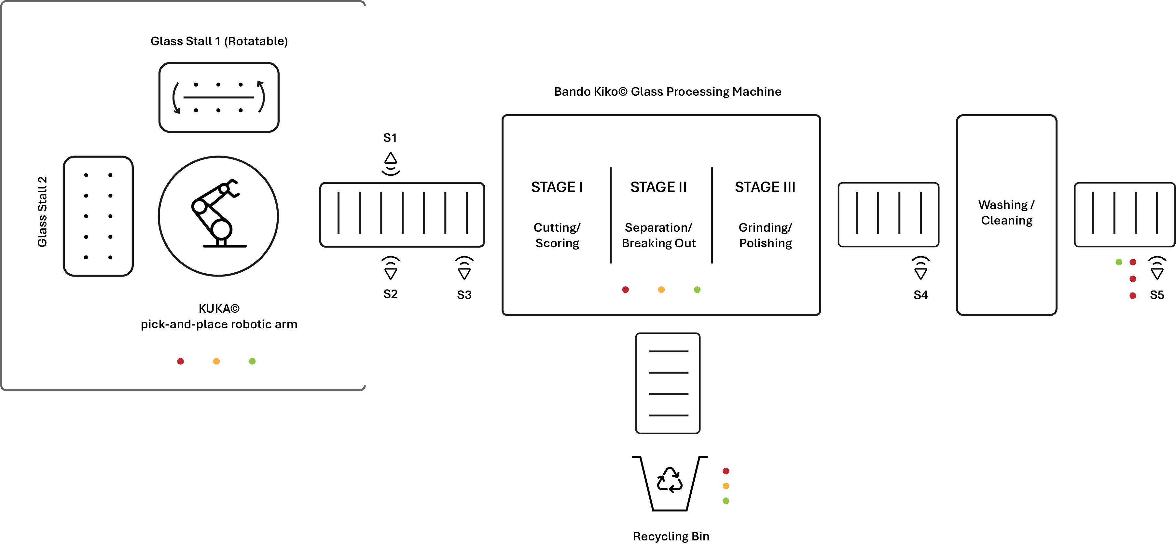
Process Flow

Slide 6
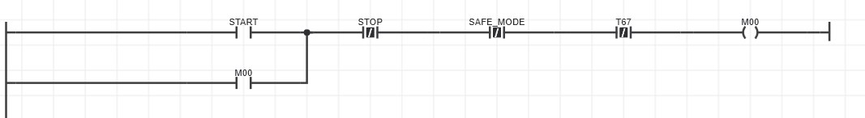
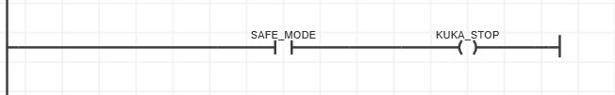
Ladder Logic
START push button starts the entire process. It is latched by coil M00
STOP ends it
Since the process begins with the KUKA robotic arm fetching glass from glass stalls, It is a potentially dangerous environment for a human operator to be around,
So, the SAFE_MODE input stops the process and enables KUKA_STOP.

Slide 7
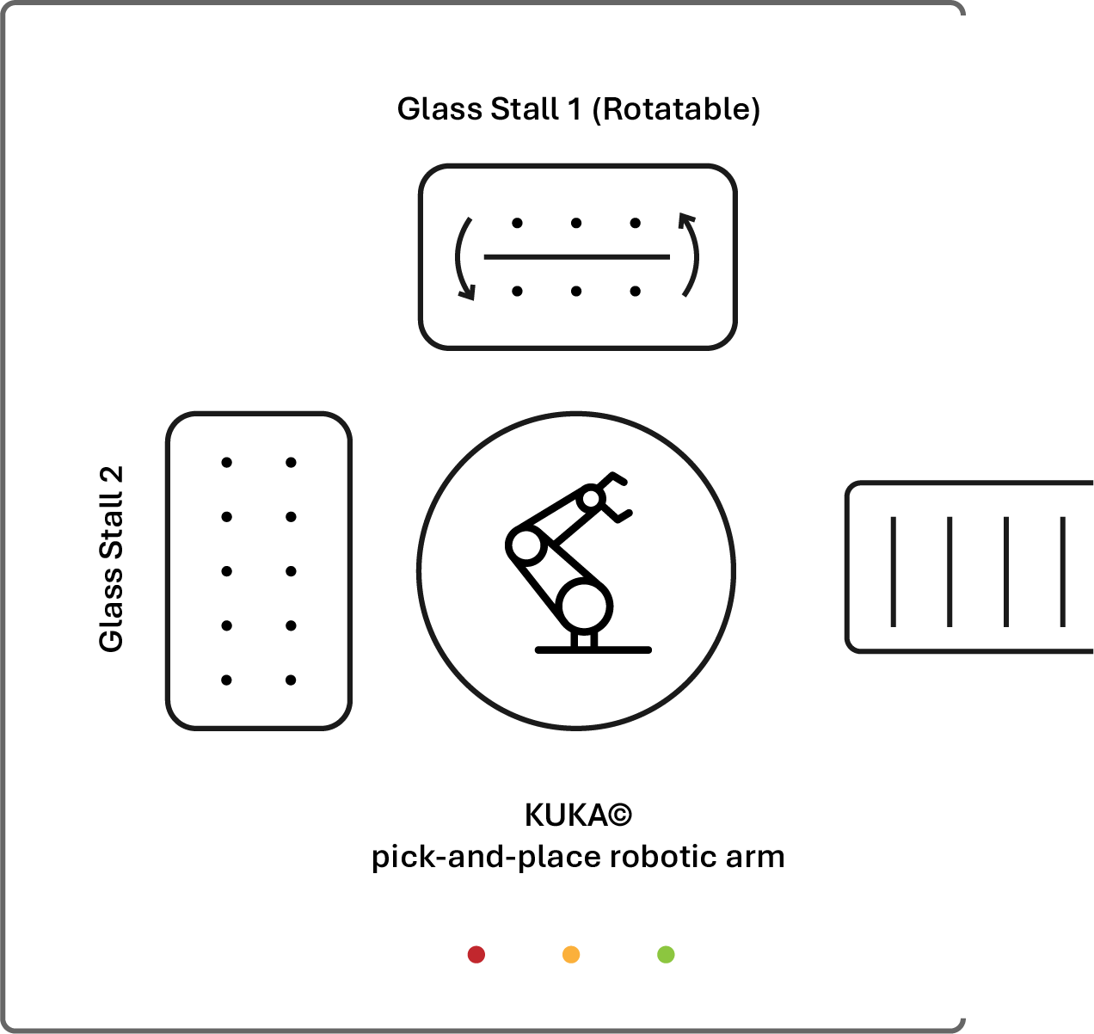
Glass Handling
First, with the dexterity of the automated robotic arm, glass items are taken from the present glass trays and placed gently on the conveyer following it
Glass stall 1 is rotatable and has 2 slots, while 2nd glass stall is fixed.
Three lights of color green, yellow and red serve as indicators

Slide 8
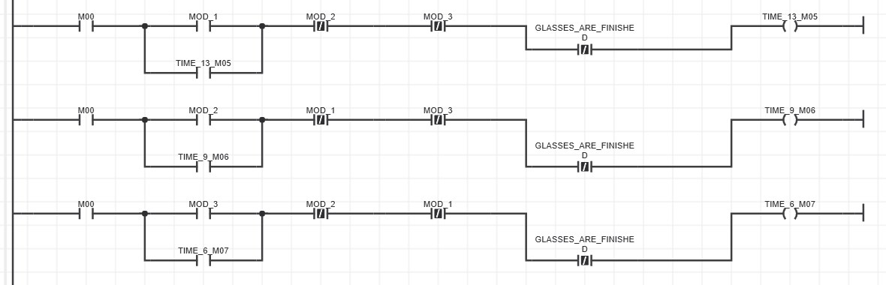
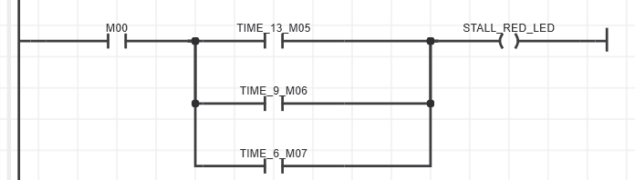
KUKA has 3 modes:
Slow (MOD_1), Moderate Speed (MOD_2) and Fast (MOD_3), that each activate and latch output coils TIME_13, TIME_9 and TIME_6 respectively
The selection of any mode, immediately turns the red light ON, indicating the are is dangerous to be around when the robot is active

Slide 9
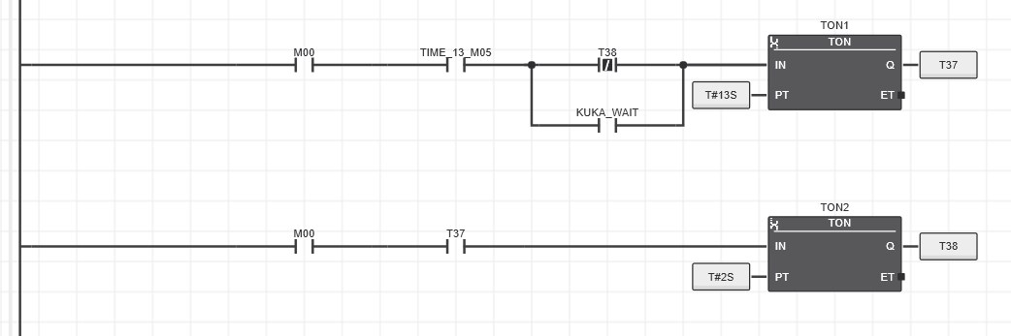
Say, slow mode has been selected (TIME_13)
It is represented here by the On Delay Timer TON1, taking it T#13sec to take a glass from a glass stall and place it on the conveyor before it
TON2 with output T38 allows the robotic arm to place it gently in a span of T#2sec.
The same case applies when the other modes are selected, but with their respective speed rate.

Slide 10
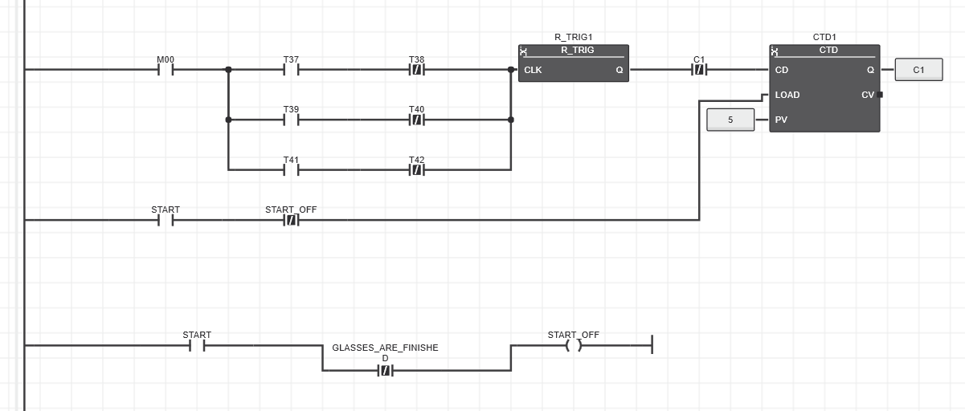
Counters keep track of the amount of glass items taken from the glass tray
As soon as an item is taken (T37 or others activated) R_TRIG enables counting
Here the counter shown CTD1, counts glasses from the first slot C1, which holds 5 items (for the purposes of this test)
START_OFF is enabled by default, which loads 5 items into the counter to count down from
it gets disabled when all glasses are emptied

Slide 11
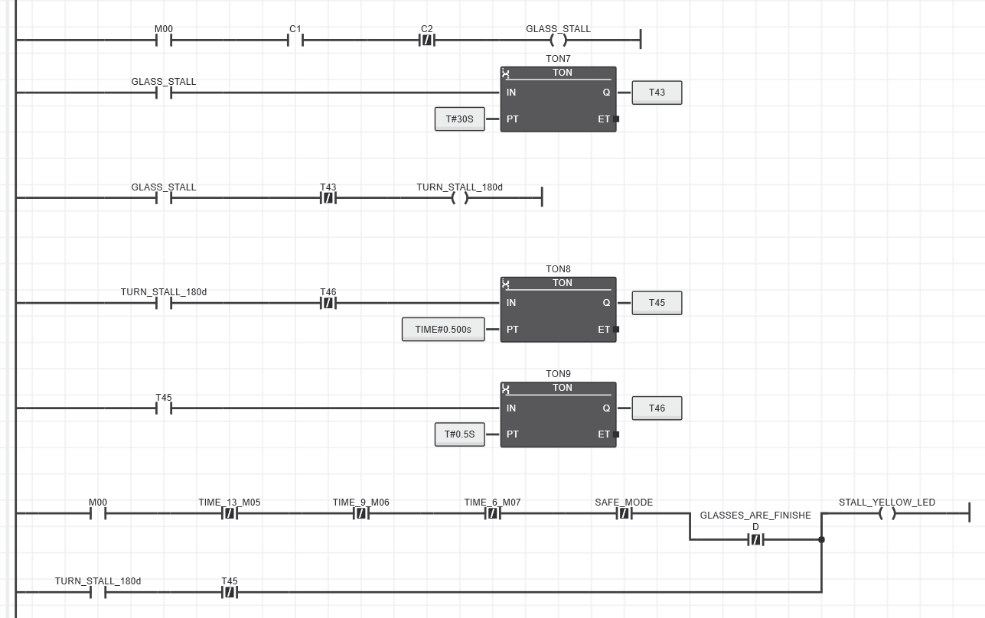
When the first (C1) of the two slots in the first tray is emptied, then T43 prompts the stall to rotate so that the 2nd slot C2 is now facing the robot.
Timers with outputs T45 and T46 enable yellow light in the glass handling section to flash with 500ms intervals while the stall is turning

Slide 12
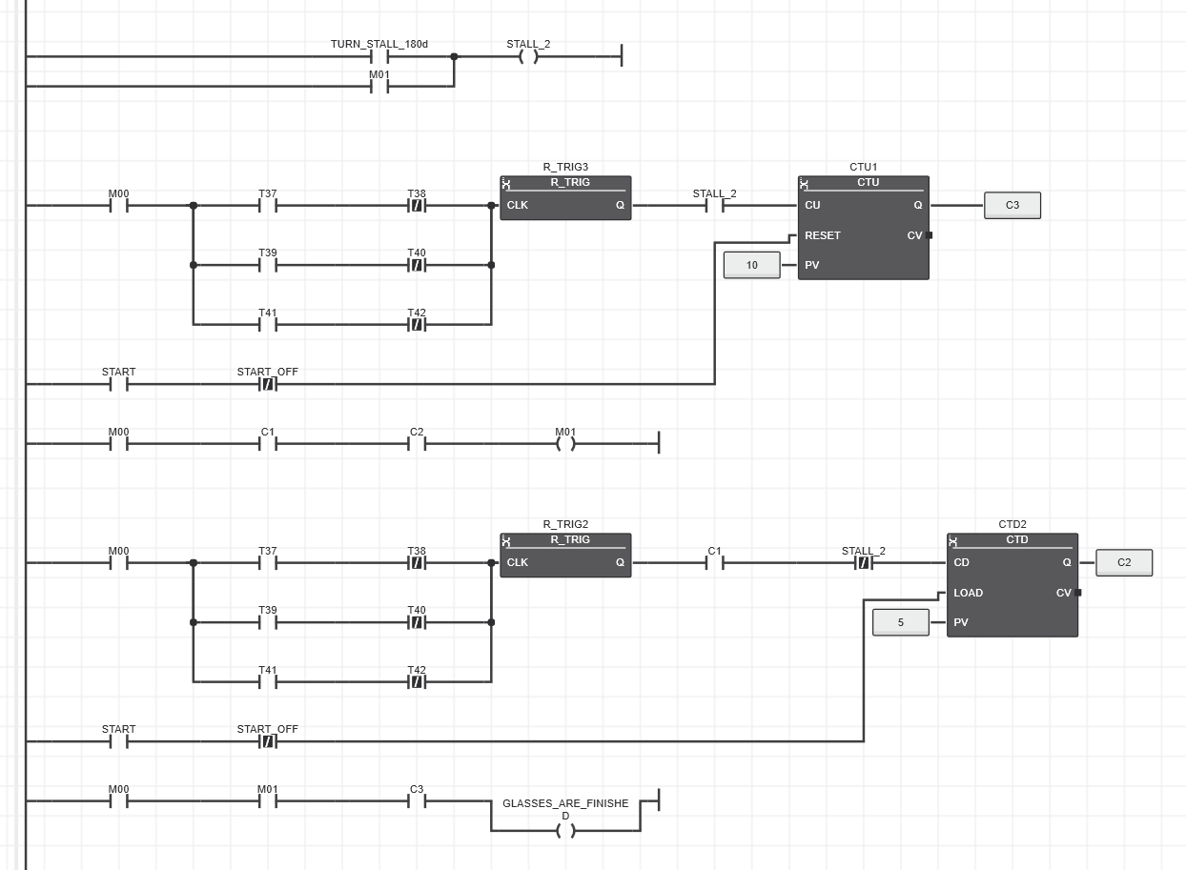
While the first tray is turning and getting the 2nd slot ready, the robot is instructed to move to the 2nd tray STALL_2 and continue its operation
Notice this stall is not rotatable and has a capacity of 10 items
It returns to finish the remaining items in slot C2 of first tray then outputs GLASSES_ARE_FINISHED

Slide 13
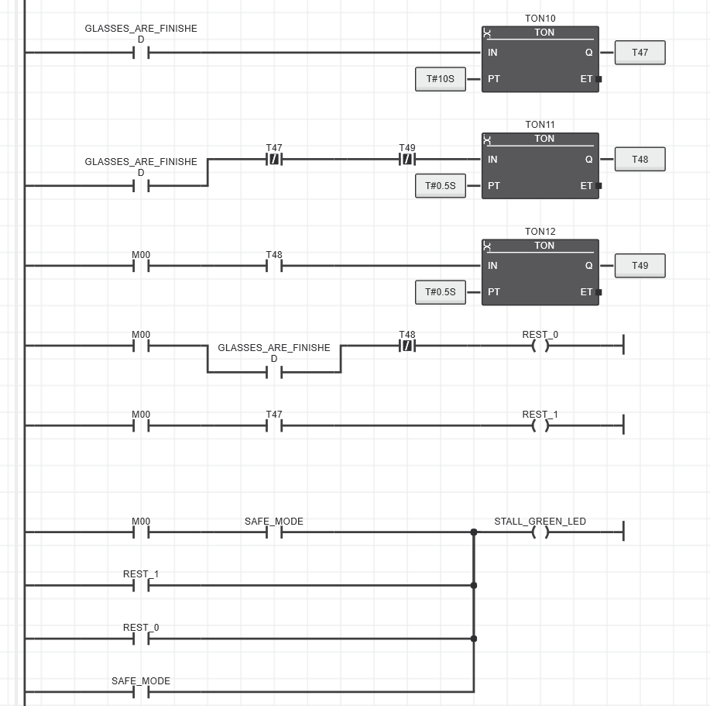
Green light flashes for 10s with the help of timer outputs T47, T48, T49.
And allows the robotic arm to rest.

Slide 14
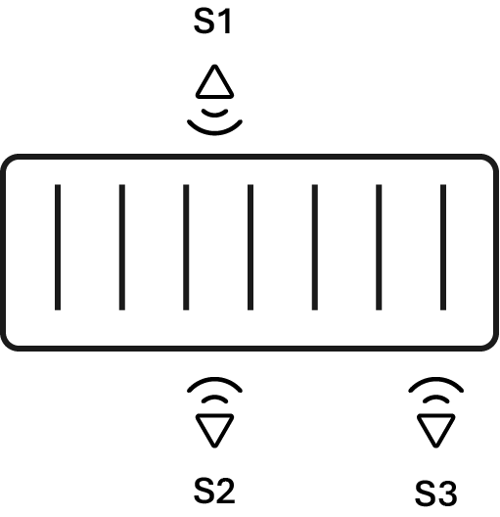
Conveyor to Glass Processor
Sensors S1 and S2 detect glass items in the rear end of the conveyor where they have been placed by the robot.
Sensor S3 scans for glass jut before the glass processing machine

Slide 15
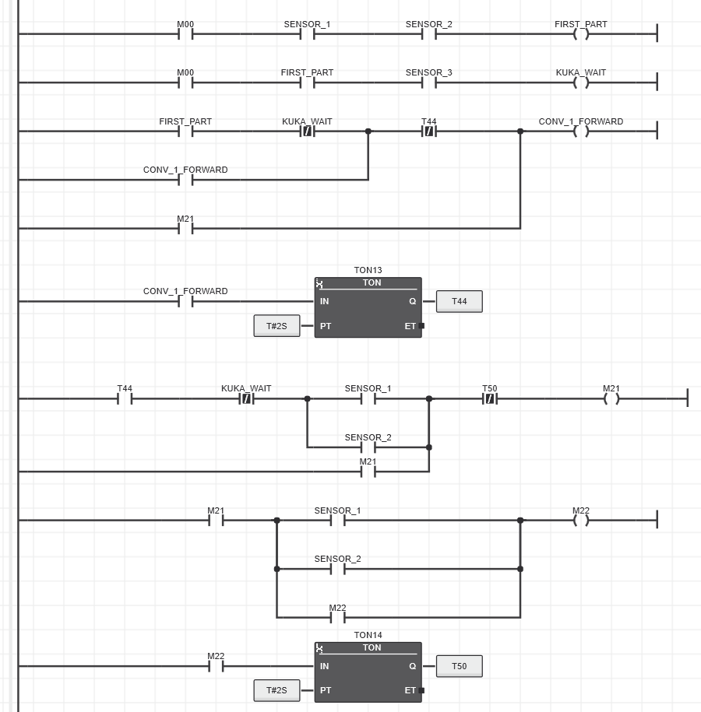
When both the sensors, 1 and 2, detect glass, the conveyor is prompted to move forward (for 2s by T44) to clear space for the robotic arm to place more items
If, in addition to glasses occupying the first area, the latter part also detects glass with the help of sensor 3, then KUKA_WAIT is enabled.

Slide 16
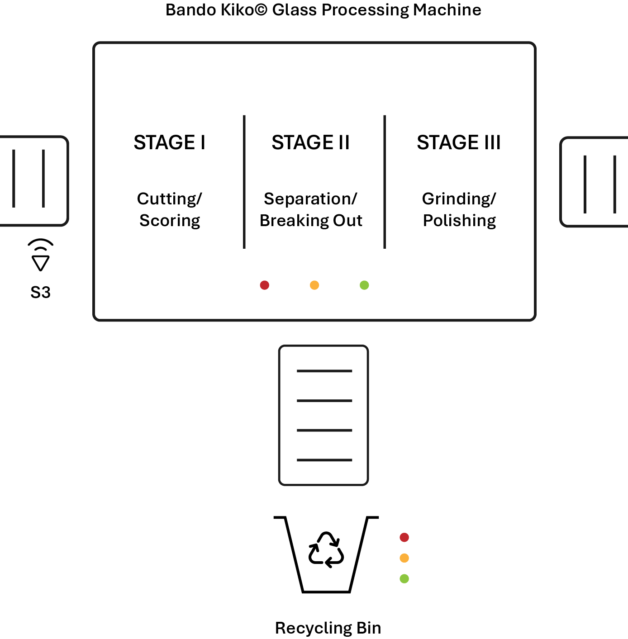
Glass Processing
Bando Kiko is a Japanese company that develops glass processing machines.
A typical glass processor handles three principal operations:
Glass material is cut/scored into the desired shape.
The excess unwanted parts are separated along the score lines, called ‘Breaking Out’.
Glass edges are ground and polished for a smooth finish.
A recycling bin has been added to hold the separated unwanted glass parts. Lights indicate how much it has been filled.

Slide 17
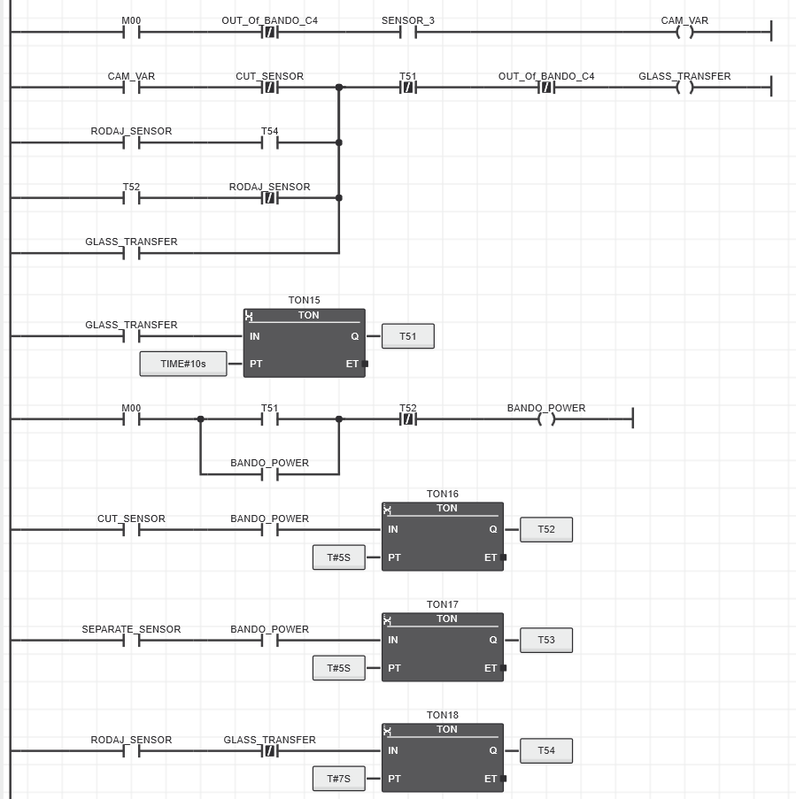
Sensor 3 detects glass and turns on CAM_VAR, which activates GLASS_TRANSFER, facilitating the transfer of glass items into the processing machine
The machine is then turned on (BANDO_POWER), which completes a batch in 10s (T51).
Sensors at each stage, CUT, SEPARATE, and RODAJ, trigger the respective operations for certain amount of time.

Slide 18
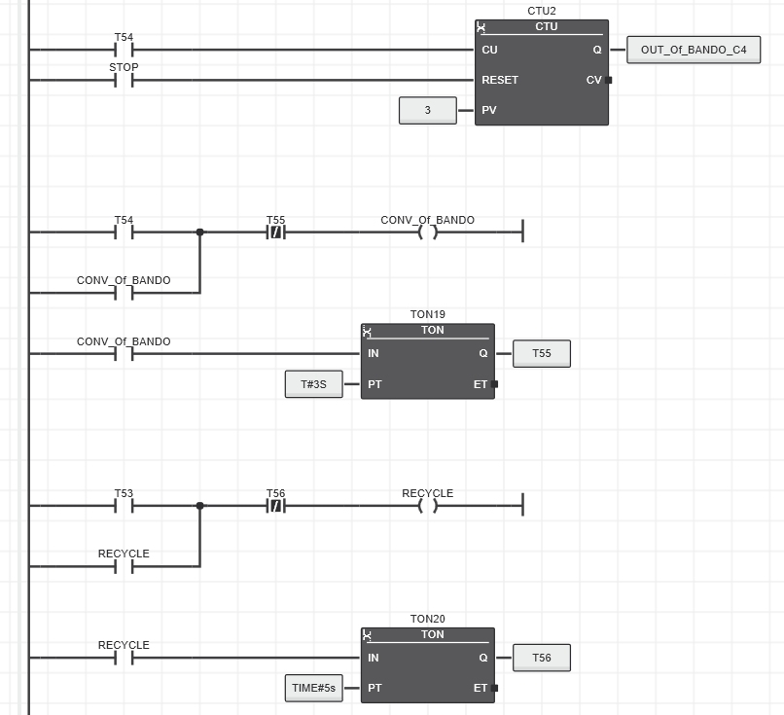
When the final grinding operation is done (T54), items are ready to be leave the machine, a counter (CTU2) counts maximum 3 items per batch before they’re unloaded via CONV_Of_BANDO, which is latched for 3s (T55)
On the other hand, when the process of glass separation is done (T53), RECYCLE is activated which discards the unwanted pieces during 5s (T56)

Slide 19
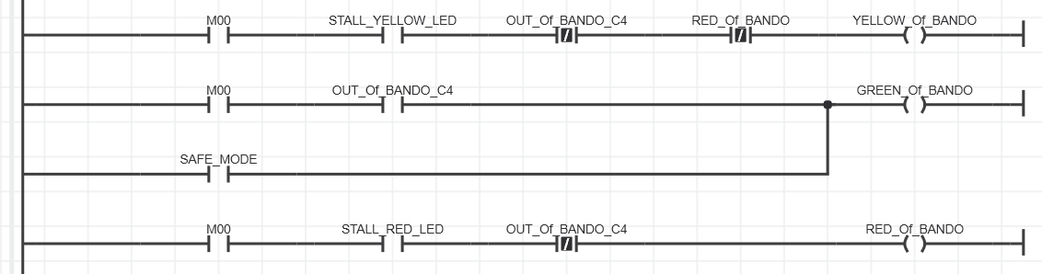
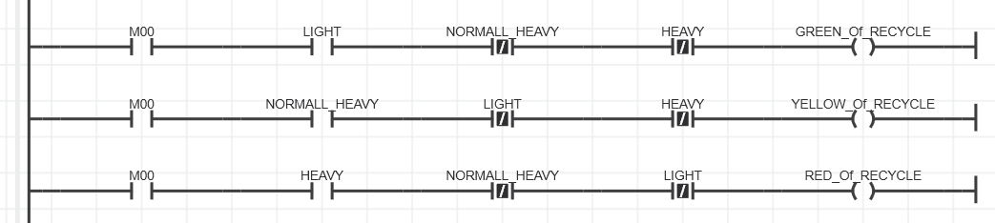
The lights on the processing machine, mimic the lights on the glass tray section.
Red indicates that the machine is active
Yellow indicates work being done
Green shows the current batch has been processed
The recycling bin has three lights of green, yellow and red on it, each of which activated by weight sensors indicate how full it has gotten, and thus suggesting the urgency of the bin to get emptied.

Slide 20
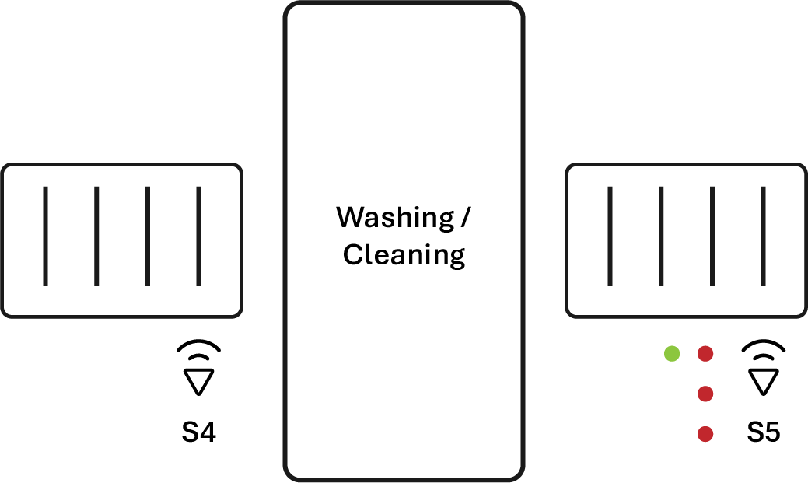
Final steps following processing
Right after the glasses have been processed, a conveyor transfers them to a cleaning cabin to wash off all the residue.
The conveyor slows down to facilitate gentle transfer
Afterwards the final conveyor presents the completely processed glass ready to be taken.
With the help of a sensor and some lights and a siren, urgency is indicated

Slide 21
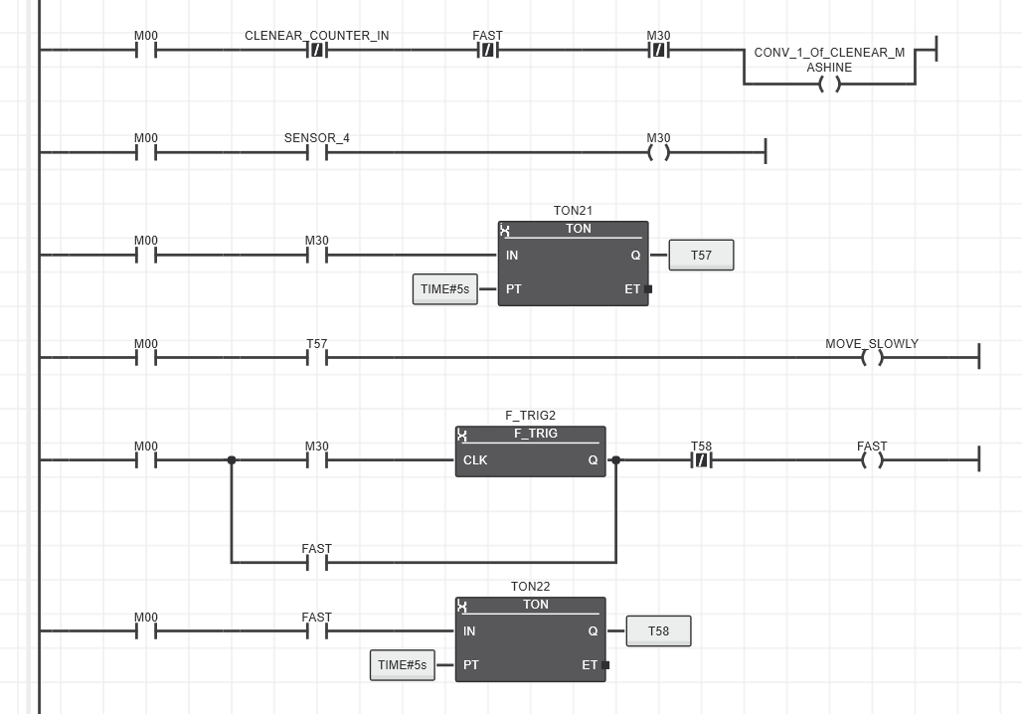
By default, the conveyor right after the processing machine moves fast to keep up with the machine
But when sensor 4 right before the cleaning section detects a glass, the conveyor is commanded to move slowly so as to drop them in gently, within 5s (T57).
Conveyor defaults to fast motion as soon as (F_TRIG2) sensor stops detecting any glass (M30)

Slide 22
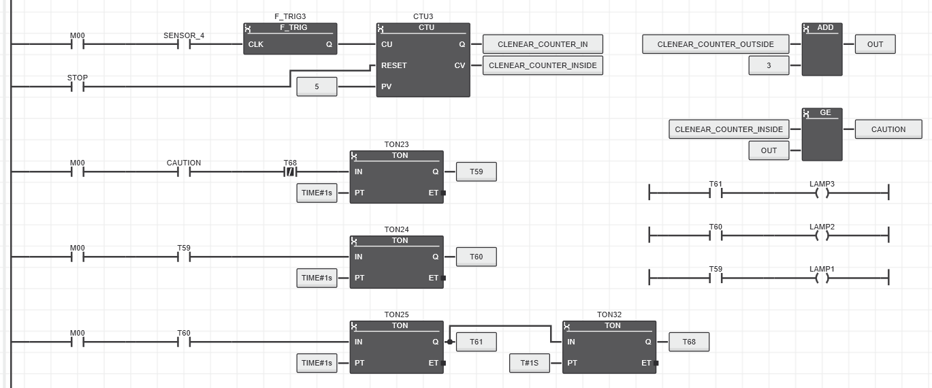
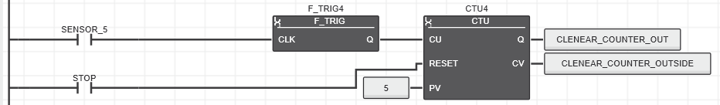
Sensor 4 also serves to keep track of the number of glass items sent to be cleaned and those that are in wait.
At any moment 5 items inside the cleaner is the limit. When there are more inside then outside, then caution is advised by 3 lights turned in succession for 1s each.

Slide 23
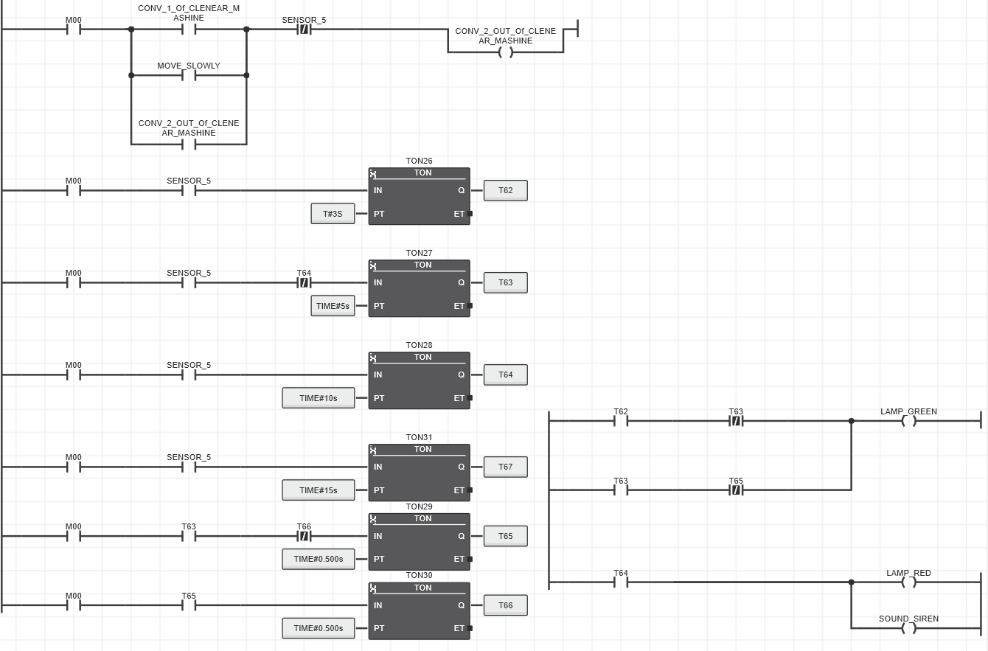
Conveyor taking items into the cleaning machine also enables the conveyor taking them out, until sensor 5 located at the end of the conveyor detects glasses and to prevent them from falling down prompts the completely processed glasses to be taken away.
When sensor 5 detects glass:
For 3 seconds (T62) green light is turned on.
After 5s (T63), green light starts flashing.
After 10s (T64), red light turns on and a siren is sounded

Slide 24
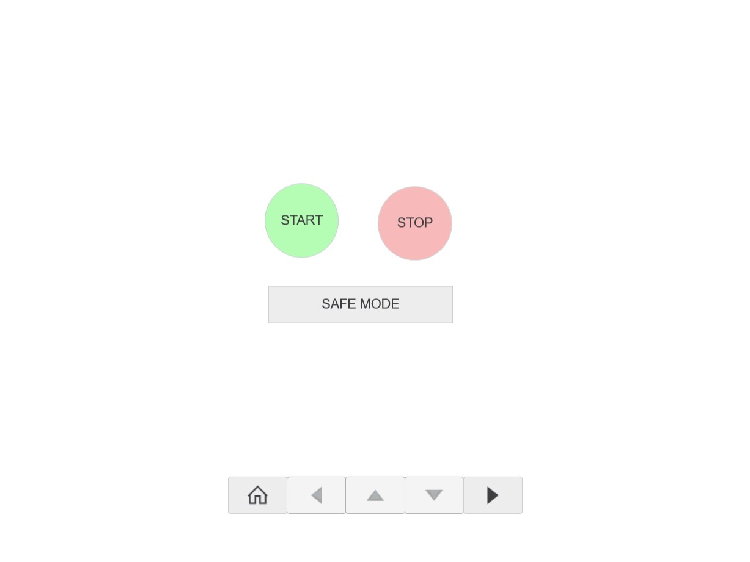
Human Machine Interface (HMI)
The HMI module consists of 5 separate pages each representing the sections discussed above
The main page begins the whole process

Slide 25
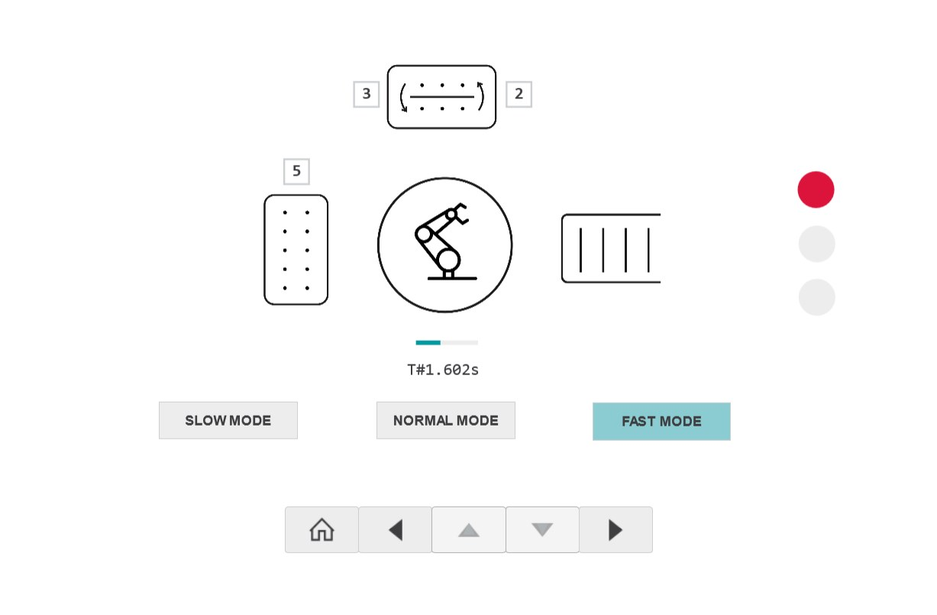
Human Machine Interface (HMI)
Glass Handling Page

Slide 26
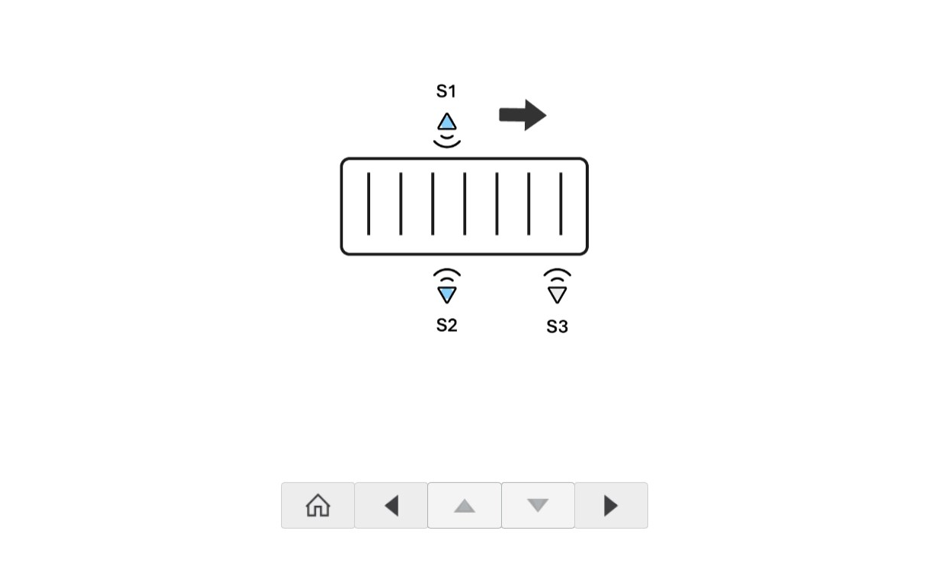
Human Machine Interface (HMI)
Transferring glass items to glass processor

Slide 27
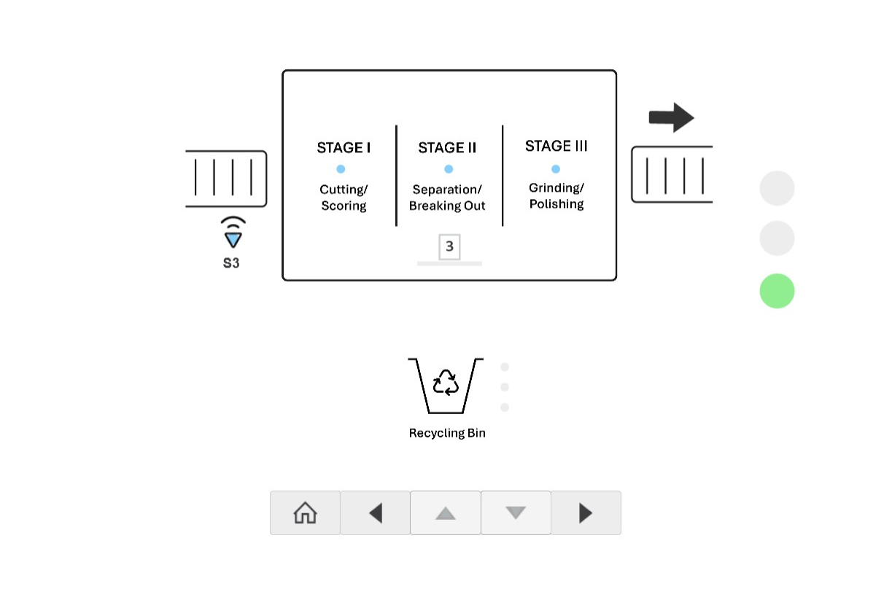
Human Machine Interface (HMI)
Glass Processor

Slide 28
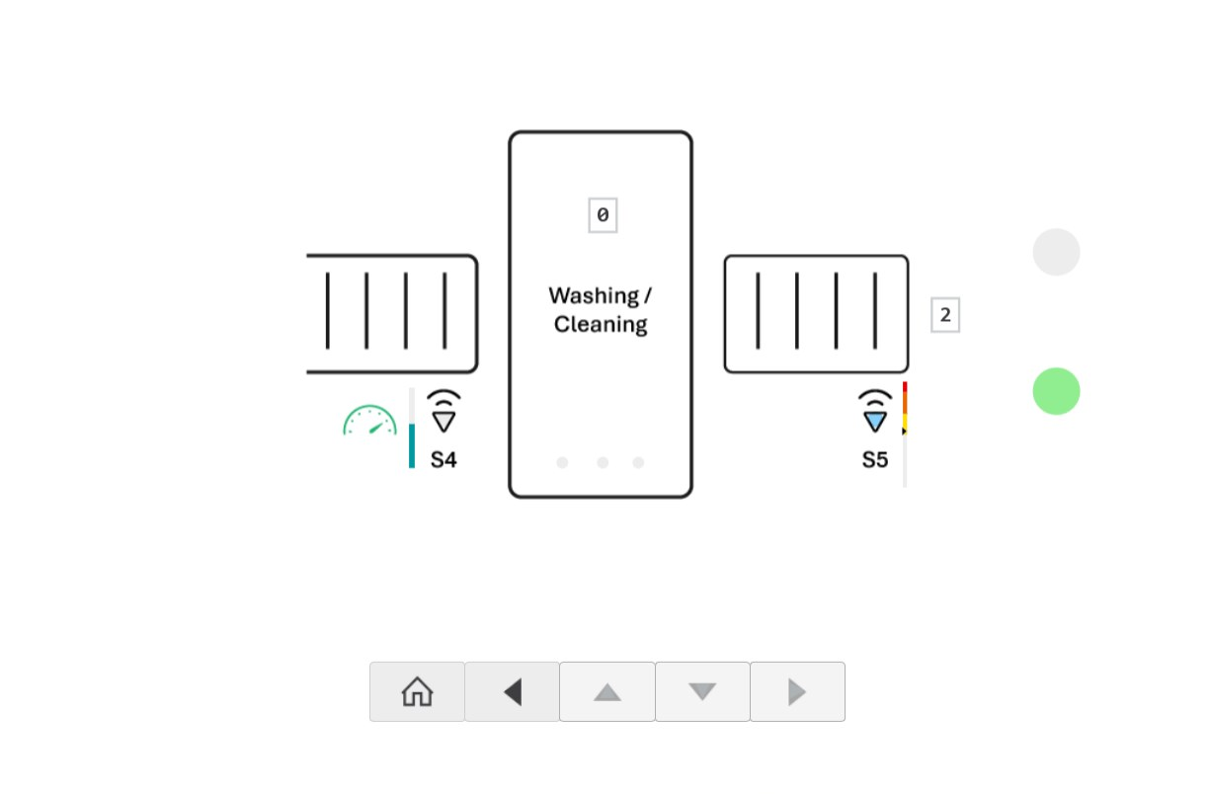
Human Machine Interface (HMI)
Glass Cleaning

Slide 29
Thank You!
All files available at the repository:
https://github.com/az-yugen/EEE-3506-PLC-Project

